Slide 1


Avamar
Data
Migration
Enabler
Adam Kirkpatrick – Last Update March 1, 2022

Slide 2
Overview this content taken from
ADMe Supplemental Material
ADMe - Avamar Data Migration enabler is a utility providing automation for the migration of Avamar backup data to a different storage medium such as tape, disk, cloud based storage, or to another Avamar/DD. Backup data is first rehydrated to a staging disk area into a structured top-level folder layout for organizational purposes. From there, it can automatically be backed up to a tape backup application as a standard file system backup or to another Avamar for purposes of placing the backup data into its Data Domain. When staging to cloud enabled storage including ECS or ATMOS or any third-party S3 object storage system using an appropriate gateway such as Geo Drive or TNT Drive, files are automatically uploaded to the cloud storage provider directly rather than passing it through a tape backup application. The ADMe migration process is comprised of three distinct phases, client backup selection to identify the backups to act on, backup recovery or staging the backup data to disk followed by an optional export to an external tape backup application or cloud synchronization phase. The end-to-end workflow is fully automated by ADMe Job Policies eliminating the need for manual intervention or localized scripting. ADMe Job policies can be scheduled to run automatically or run on demand as needed.
ADMe is compatible with all Avamar systems including single or multi-node GRID systems, source or replication target systems, IDPA and those using Data Domain storage. Several tape backup applications refer to compatibility guide for details, are supported and leveraged in a consistent manner for purposes of automation. Performance varies based on the infrastructure involved and the migration strategy used incremental or non-incremental. Non-incremental typically averages ~50-150 GB/Hr per migration thread during the rehydration phase with slightly higher rates when file counts are low or larger files are involved. Incremental staging is effective against large file system or NDMP backups only and can provide effective staging rates up to ~500 GB/Hr with a single staging thread. Multiple staging servers can be leveraged where each can support multiple staging threads all of which can be leveraged concurrently to increase the aggregate throughput. The tape backup phase performs at the tape applications normal rate for a file system type backup.
ADMe – Avamar Data Migration Enabler is a utility providing a framework for migrating Avamar backup data to a different storage medium such as tape, disk a target Avamar or cloud based storage
Notes:
The link to the ADMe home page is the link shown in the slide.
Use it to obtain a copy of ADMe, Release Notes, User Guide, Presentations etc.

Slide 3

Features
Single point of management
No dependency on Avamar when recovering from tape or cloud
(exceptions Oracle or PAX archives)
Seamless support for different staging platform OS types
Supports migrating Avamar backup contents in bulk to Hybrid cloud storage via various gateways
Cataloged tape backups
Indexed and searchable cloud copy
File level recoveries directly from tape or cloud
Supports multiple staging servers and optionally multiple migration threads per server all of which can be used concurrently
Easy to use CLI interactive Menu driven UI
(Web based UI is almost here)
Batch driven migration process
Supports all Avamar system types
Automated export backup initiation
Email notifications & job logs capture all migration activity
Incremental & non-incremental migration strategies
Supports all popular Avamar plug-in types
Extensive backup selection filters
Recoveries visible in Avamar Activity Monitor
Notes:
The versatility of ADMe has grown over time now supporting migrations to the following media types;
Tape, VTL, Disk, USB Hard Drives, External Jbods, DataDomain, Cloud Storage via the use of various compatible gateways.

Slide 4







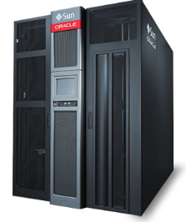


Export to Tape Workflow
(Networker Shown)
Migration Workflow
Using Networker
Avamar Server
(ADS or AV/DD)
Networker / Staging Server
Additional Staging Servers
Desktops
Laptops
Networker / Tape App FS Client Agent
ROBO
Avamar FS CLient
Avamar FS Client
Local ADMe staging disk file systems
Networker / Tape FS Client Agent
Local ADMe staging disk file systems
Files
NAS/NDMP
Networker 64 Bit Linux
FS Client
Pre-defined Networker policy points backup to designated target storage using appropriate retention.
DB
VMware &
Hyper-V
Databases
Email
Applications
Automated Tape Library
Tape/VTL/DD/Cloud/Disk
Technologies Legend
EMC Networker
Avamar
Notes:
This workflow represents migrating Avamar backup data to a supported tape application. ADMe facilitates automation of the backups selected, the staging of the backup data to a defined staging disk. Once staging completes ADMe can optionally initiate a call to the tape application to start a predefined tape policy specifically configured to capture only the staging data path being used. A completion status from all phases is then reported back ADMe. ADMe is therefore performing the role of an external 3rd party scheduler to initiate the tape backup.
If using non-incremental staging staged data is automatically removed if its corresponding tape export phase is confirmed to be successful. This allows room for subsequent migrations to reuse the same staging disk area. If the tape export phase is detected to have failed, ADMe by design will not remove the staged data allowing the user to correct the issue and retry the export phase eliminating the need to restage the data involved.
If using incremental staging no removal of the staged data takes place allowing ADMe to maintain one copy of a given client’s backup data on the staging disk between migration sessions which is then used to perform a time stamp comparison from the backup being staged to the same but previously staged file names. Only net new or updated files will be moved during subsequent migration sessions thus significantly reducing the amount of data being transferred across the network. The use of incremental staging is a prerequisite if one chooses to leverage an incremental tape export which improves tape run times and significantly reduce the amount of tape cartridges consumed.

Slide 5







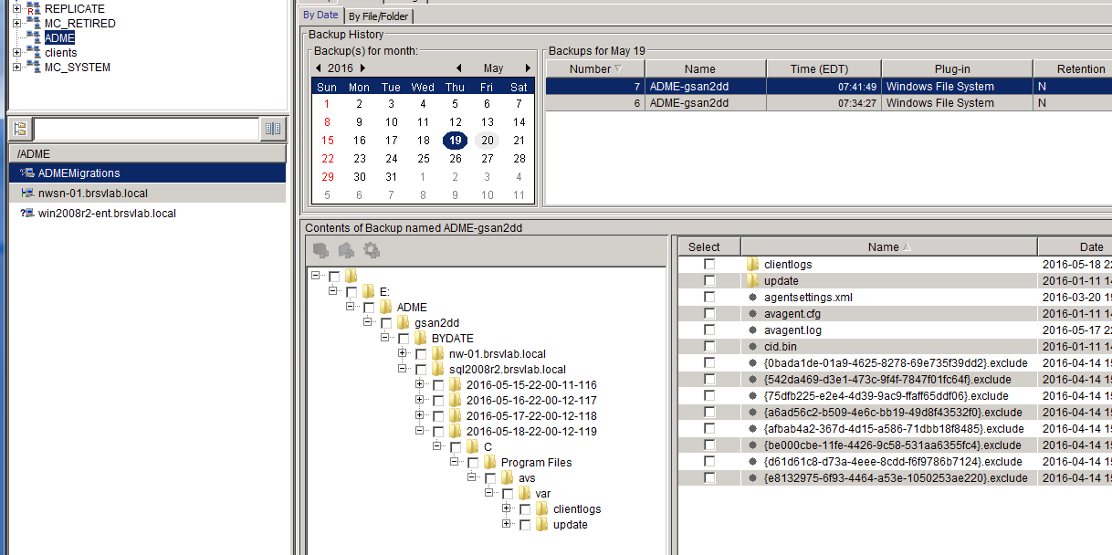
ADMe Avamar GSAN/DD -> Avamar/DD Workflow
Migration Workflow
Migrated backups will be stored on target Avamar Data Domain as a net new backup
Expiry times passed as part of the ADMe migration job policy criteria
Incremental staging can be leveraged in suitable scenarios
DD-Boost leveraged during ingest to target Data Domain
Supports multiple concurrent migration threads
Automated end-to-end workflow
Migrations can be performed before/during/after activating production clients to new target system
Staging server activated to source Avamar only
Desktops
Laptops
Staging Server
Avamar Client
Files
NAS/NDMP
Local
Storage
Volumes
ROBO
DB
Source Avamar Server
(ADS or AV/DD or IDPA)
Target Avamar Server
With Data Domain
Recovery UI
VMware &
Hyper-V
Databases
Email
Applications
Recovery Experience
Almost business as usual for fiel system backups
Uses target Avamar Recovery UI
File level granularity
Each migrated backup browse-able at the client level and its original backup date displayed as a folder
Files retain their original timestamps
Recoveries can be to any available activated Avamar client
Plug-IN’s recoveries require using ADMe documented procedural recovery process
Notes:
A secondary use case of ADMe is to migrate ADS (GSAN/Hybrid/DD backups) to a new target Avamar host where DD is used as the backup target. With this use case it is the users responsibility to ensure all required clients are configured and their remaining retention periods are maintained on the target system during the migration.
ADMe acts on the BU content usually of yearly or monthly tagged BU’s staging their data then subsequently initiating a net new BU into the target Avamar to a common account named /ADME/ADMEMigrations to which a net new retention period is assigned to it as defined within the ADMe job policy definition used.

Slide 6
Staging Method - Non-Incremental
CONCEPTS
  Referred to as BYDATE as it establishes a unique top-level folder representing the point-in-time of the original Avamar backup formatted as yyyy-mm-dd-hh-mm-buid#
  Performs a full recovery of all files contained in the backup
  Provides separate point-in-time copy for each backup migrated
  Effective with both Tape, Cloud targets and ADS migrations
  Can be used with all backup types
  Staging disk is automatically erased between migration sessions
REQUIREMENTS
  Minimizes staging disk space required
  Must be large enough to accommodate size of largest individual backup
  From a practical sense, at least 4+ TB’s should be available per staging thread
  For a Windows staging server, multiple staging drive letters are required in order to leverage concurrent migration threads
PERFORMANCE
  Expect throughput of 50-150 GB’s/Hr per thread
  No dependency on file change rates between migration sessions
  Throughput impacted by high file counts and/or slow infrastructure
  Tape media consumption based on data size and its ability to compress
  and model of tape drive used
Notes:
Non-Incremental staging to Windows requires the drive letters involved be dedicated to ADMe use. ADMe will leverage a quick format call to ensure the drive contents are fully deleted. The quick format call is defined within a job policy definition using syntax –upst FORMAT-G which would format Drv-G in this example but will only be called is the associated export backup completes successfully.
If the -upst call is not present ADMe will fall back to use Windows delete command however this is not reliable and will only be effective with plug-ins such as VMimage or sql etc. File system data requires the use of a quick format command otherwise folders and files from previous staging will be left behind.

Slide 7
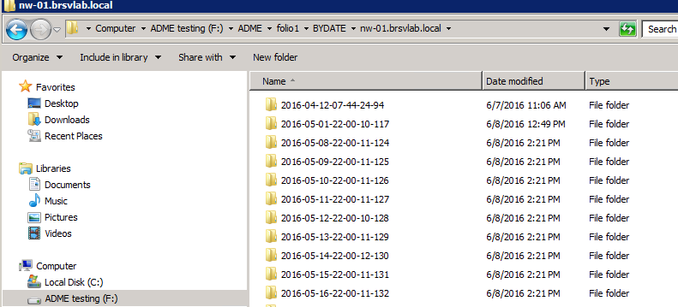
Staging Folder Hierarchy - Non-Incremental
Destination staging path automatically includes Avamar source client names and point-in-time folders
Point-in-time folders
ADMe establishes the user defined top level folder structure along with the source client names involved
Insert keyword BYDATE prior to the source client name
Insert point-in-time folder YYYY-MM-DD-HH-MM-buid#
  represents the migrated backup original Avamar timestamp and associated BUID#
User data will be present under the point-in-time folder
Notes:
With non-incremental staging ADMe automatically inserts a point-in-time folder formatted as YYYY-MM-DD-BUID# to differentiate between each backup migrated and whose values represent those of the original Avamar backup date & time along with its associated backup-id#

Slide 8
Staging Method - Incremental
CONCEPTS
  Overwrites previously staged path name
    Point in time folder is removed with incremental staging
  Performs timestamp comparison prior to moving the file across the wire from current backup with the same previously staged file name
  Only net new or updated files are moved
  Deleted files remain on staging disk until it is manually formatted
  Provide single instance at the file level on the staging disk
  Effective for Tape and Cloud targets
  Benefits File System or NDMP Plug-IN types only
REQUIREMENTS
  Incremental staging is relative to previously staged data, 1st stage is always a full
  Requires one copy of staged data remain staged between migration sessions
    Therefore, staging disk must be dedicated
  Minimum staging disk space required equivalent to ~one copy of client BU data involved
  For an incremental tape-backup, incremental staging is a prerequisite
PERFORMANCE
  Effective throughput gains versus non-incremental usually ~3 to 6 times
  Expect ~250-600 GB’s/Hr effective staging throughput
  Highly dependent on % incremental change rate & total number of files involved
  Comparable performance gains achieved for incremental tape backup phase (optional)
  Usually ~70%+ reduction in tape media usage
Notes:
Incremental staging is invoked using the –inc flag in the Migration Criteria of a job policy definition.
Incremental staging maintains one copy of a clients backup on the staging disk between migration sessions to be used to leverage their file time stamps for comparison to the same file names in the current backup being staged. Therefore, incremental staging requires dedicated disk space for each client involved and it cannot share a disk with non-incremental staging on Windows.
Incremental staging can be beneficial for large FS or NDMP backups only especially those containing high file counts. During the incremental staging phase a timestamp comparison is performed between files being recovered from the selected backup to those file previously staged and already present on the staging disk. If the current backup file version is newer it will overwrite the existing file and for a net new file it will simply stage the file. All other files will effectively be skipped reducing the amount of data transferred over the network and reduce the overall run time involved. When file change rates from one month to the next are high the advantage of using incremental will diminish therefore some knowledge of the backup content involved is needed.

Slide 9
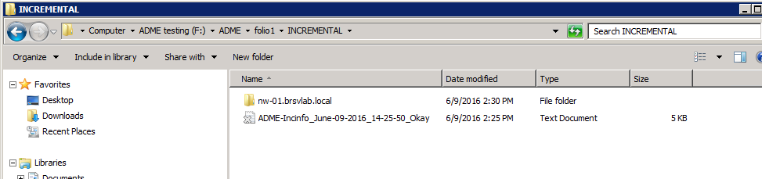
Staging Folder Hierarchy - Incremental
Incremental destination staging path automatically includes Avamar source client names but NO point-in-time folder
A prereq of incremental is the need for a consistent path name. As a substitute for the lack of a point-in-time folder a txt file is provided containing the details of a given migration including that of date/time/buid# etc..
ADMe establishes the user defined top level folder along with the source client name involved
ADMe Incremental relies on a consistent path name to a client's data therefore a point-in-time folder cannot be used
To replace the point-in-time folder, a text file named ADMe-Incinfo is provided containing details of the migration including metrics such as date/time/BUID# of backups migrated
An effective incremental tape backup can be accomplished from incrementally staged BU’s
Notes:
With incremental staging it must stage to a common path therefore creation of the point-in-time folder provided with non-incremental staging is not available. ADMe provides an information stat file in its place located immediately under the INCREMENATL folder which containing details of which backups were selected and staged along with their completion status. These small text files one per migration session and can be referenced as needed to determine the original backup dates involved.
When exporting to a tape application it will provide a backup date associated for a given migration.

Slide 10
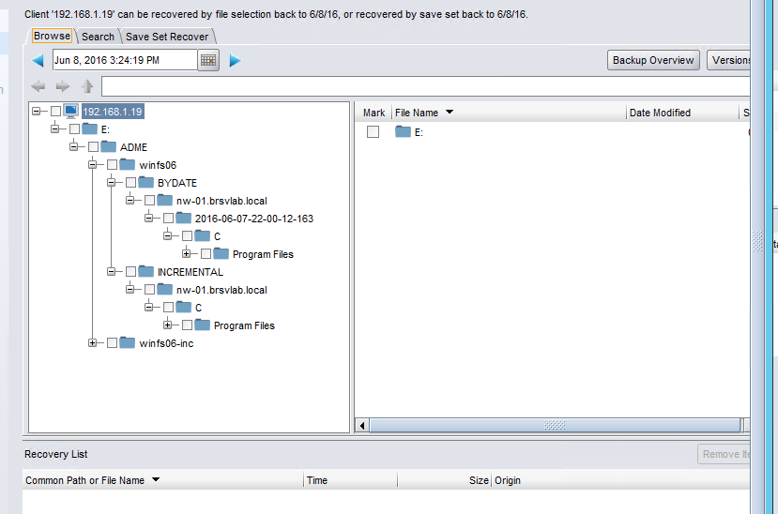
Tape Application Recovery UI View
(Networker shown)
BYDATE = Non-Incremental
Its point-in-time folder represents its original Avamar backup timestamp
INCREMENTAL = Incremental
A common destination folder is used, tape export application provides the effective point-in-time reference
File Recovery From Tape
Choose desired backup by date from applicable staging server
Navigate to staging path and source client folder name
Mark files/folders to be recovered as a directed recovery from tape
Notes:
Data migrated to an external export application whether it be tape or a target Avamar system relies on that applications recovery UI to perform file level recoveries from it. Since all tape migrations result in a cataloged backup on tape it is usually searchable and can identify the various dates an export backup took place. File level recovery from tape or target Avamar is accomplished by browsing the backup tree within the recovery UI then using it to perform a directed recovery to either a staging server which by definition must be a defined activated client or you can recover to any compatible client which may also be activated to the export application whether it be tape or Avamar.

Slide 11

Questions?

Slide 12
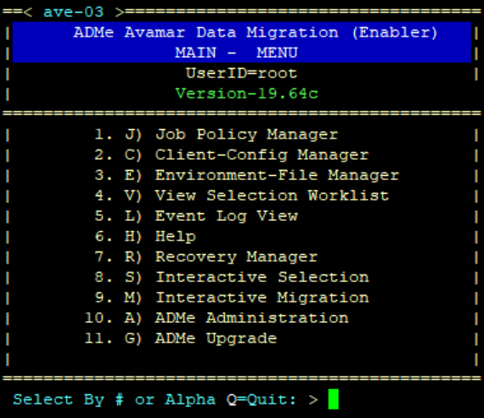
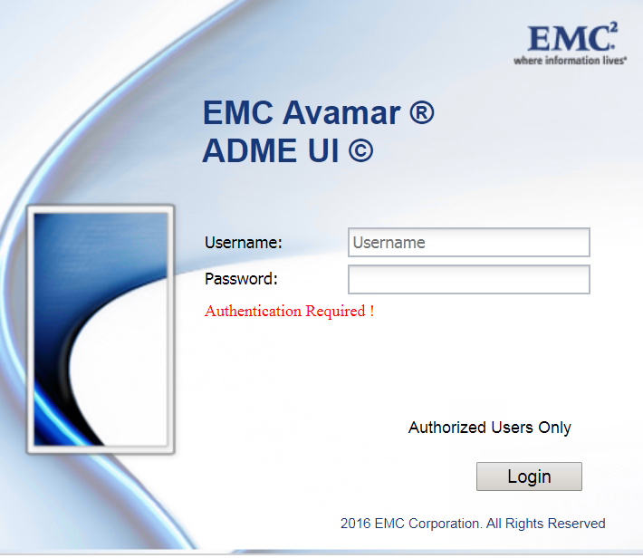

User Interfaces
CLI Interactive Menu UI
Interactive Menu Driven
All Functionality Available
Color Coded Displays
Easy Access to Logs
Online Help
Automated Upgrade Process
ATO Rocks!
New Web based UI
Most Common Functionality Available
Job Policy Setup, Scheduling & Monitoring
Easy Access to Job Logs
Login via MCS authentication
Notes:
There are two available UI’s are similar in terms of their logical organization. However, the CLI Menu is more complete and supports lesser used functions. Both UI’s can coexist and can be used concurrently. The ADMe User Guide is written primarily around the use of the Web-UI with the Menu UI referenced only when needed. The goal is to have all required functionality within the Web-UI over time.

Slide 13
Step-1
Establish environment files which define the staging server names or staging thread name where you intended to stage your backup data to. These can be shared by different client groups and job policies or they can be dedicated if appropriate.
ADMe Architectural Overview
Environment File Definitions
Staging Server Name
Staging Server Type
Export Application Name
Export End-of-Year Month-ID’s
Mail-Notification Address’s
ADMe Control variables
Avamar & Tape Binary paths
Step-3
A Job policy definition references an environment file by its numeric number, a client group name, backup selection and migration criteria customizing the migration process based on user requirements.
Job Policy Definitions
Environment-File-Number
Client-Group-Name
Backup Selection Criteria
Backup Migration Criteria
Execute the Job
Client Group Definitions
Group-Name
Client domain/name
Staging Path
Tape-Export-Policy
Staging Server OS type
Step-2
Establish client group(s) by giving it a name and adding the desired clients to it. A client group can contain any number of clients, but their aggregate size must not exceed its defined target staging path. Client groups are assigned to a job policy definition to be acted on.
Notes:
This slide shows the relationship and where key attributes are defined within ADMe. For example, attributes stored within environment files, a client groups and a job policy definitions. Familiarizing yourself with where these key attributes are defined will improve your ADMe experience considerably.

Slide 14
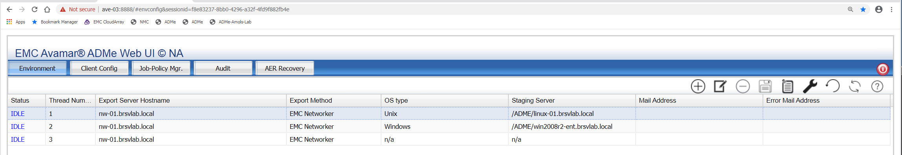
Environment Files
Environment File Purpose
Defines the physical infrastructure available to ADMe including staging server names & OS type, export tape application, binary paths, temporary workspace
Contains several customizable operational variables
Defines the mail notification recipients
Tool Bar Functions
Establish a new Environment file
Update an Existing Environment file
Remove an Existing Environment file
Save an inline edit change to an Existing Environment file
Display and Email an Environment Summary report
Refresh filters and Environment display contents
Help information
Notes:
Environment files are used by ADMe to define primarily the physical infrastructure involved. It contains a series of variables defining binary path values, staging server hostname and several other customizable attributes. Each migration thread must be assigned to a given staging server name therefore separate environment files must be defined for each being used.
ADMe supports via a custom procedure the ability to support more than a single Avamar MCS session to a given staging server improving its throughput capabilities. In this scenario unique names are assigned to each thread therefore each requires its own environment file definition. Refer to the tools wthreads2 bat file for Windows and Lthraeds.sh for Linux used to establish the multiple MCS threads.
A job policy references any environment file by its numeric number. A given environment file can support only one job at a time therefore, if an attempt is made to run another job policy using the same environment number an Environment lock violation will be returned resulting in the additional job immediately aborting as the initial job is the owner of its lock. This condition can be mitigated by using ADMe Batch job policies described in a later slide.

Slide 15
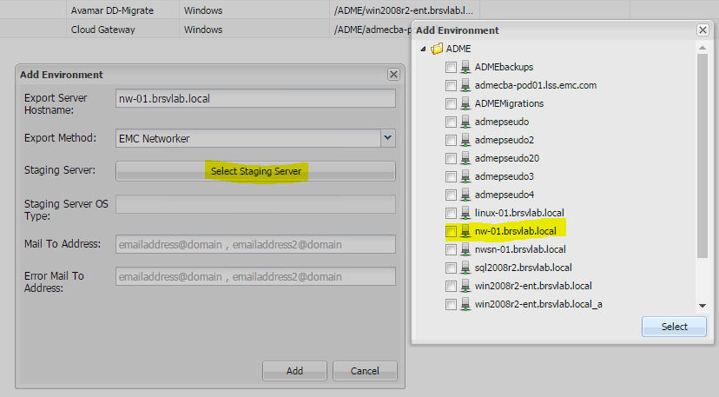
Environment File Creation
Click on Environment Tab
Click on + tool to create a new Environment file
Click on Staging Server button
Choose the desired staging server from the client tree displayed
Notes:
Creating an environment file is done using an interactive process then navigating the client tree displayed and checking on the staging server name for it to use. Binary paths are initially set to default values which suffice in most cases but these can be adjusted individually afterwards based on where the various software components Avamar and Tape application agents have been installed.
Environment file 1 is unique as it is established automatically at the time ADMe is installed. However, key variables such as the staging server name, export application and export application server name will be empty therefore these must be manually updated. The ADMe Web-UI will not allow establishment of additional environments until Env-1 is appropriately updated.
Env-1 is also unique as key variables from it including export application and server name, binary paths and email notification address’s values are propagated to any additional environment files you establish saving you time and helps promote accuracy. It is important Env-1 be fully updated prior to establishing any additional environment files.

Slide 16
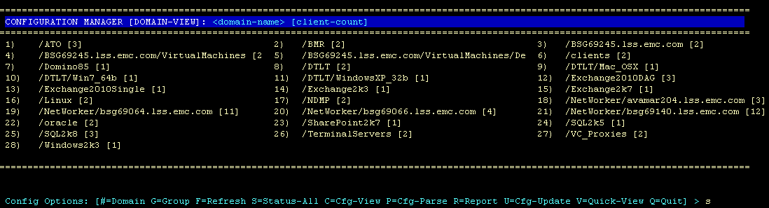
CLI-UI Client Configuration Manager
Avamar Domain View
Avamar domain display
Drill down to view clients in each domain
Value in [ ] brackets = the client count
Display ADMe client groups
Client Configuration File parse check & view
Display of all clients in a single view
Refresh option for rediscovery of domains & clients
Notes:
The CLI based Client Config Manager is used to view all Avamar domains and their associated clients. You can drill down into a domain to view its client names. From any level of the display where clients names are visible a client can the be A=Added to an ADMe client group. A client must be defined in a group in order to have any of its backups migrated. A client entry includes its domain/client-name, staging path, export policy to call and optional embedded filters used to influence the backup selection process.
This display is cached therefore if any new domains and/or clients are added to Avamar you must manually force a refresh of the discovery using option F=Refresh in order for ADMe to see the newly added objects.

Slide 17
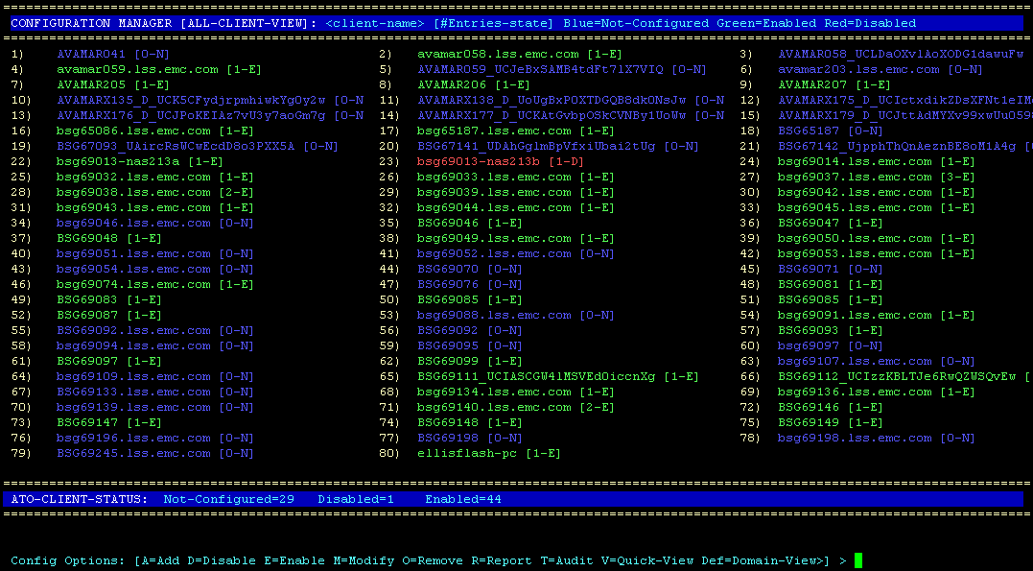
CLI-UI Client Configuration Manager
Avamar Client View
Status view of all Avamar clients
Color scheme indicates client configuration status relative to ADMe
  Green=configured to ADMe, Red= configured but disabled, Blue= not-configured to ADMe
Notes:
The CLI color scheme is significant enabling you to visually identify whether a client is enabled for migration or not.
Blue indicates the client name is present in Avamar but has not been enabled to ADMe
Green indicates it is available in Avamar and it is enabled to ADMe for migration
Red indicates it has been disabled but still present within the client configuration file. A disabled client will be excluded from the migration process. Disabled clients can be re-enabled or removed as required.

Slide 18
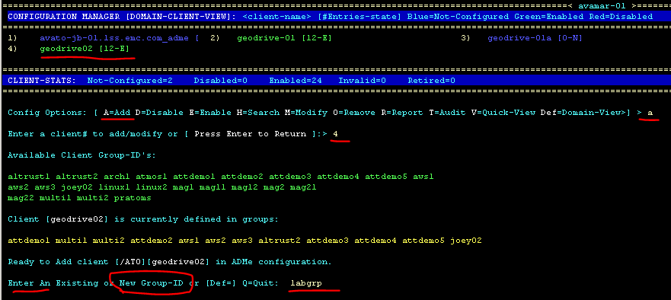
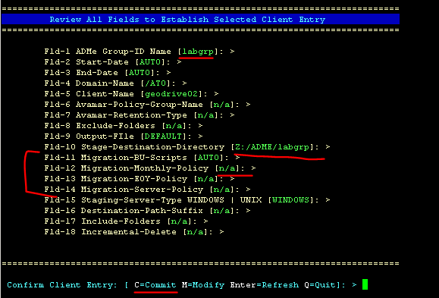
CLI-UI Client Configuration Manager
Create a Client Group
Notes:
A CLI client entry is comprised of a one line entry in a 18 field csv file. The file atoclient.cfg can be viewed, parsed, modified and edited directly from CM although manual editing is discouraged due to the potential for inducing errors. The interactive options provided should be used for all additions and modifications to this file.
The parse check option is especially useful in detecting known typos and/or invalid values in a given field.

Slide 19
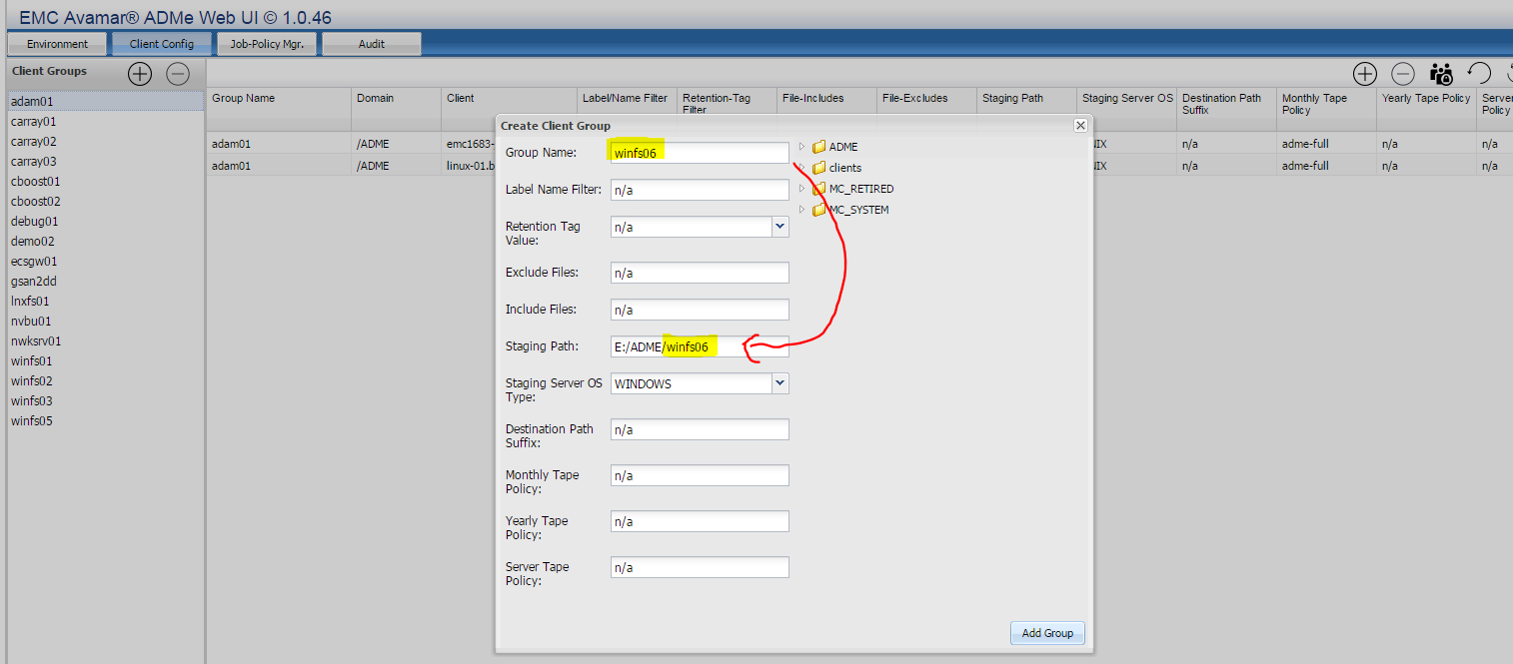
WEB-UI – Client Configuration Manager
Create a Client Group
Tape Policy fields
Browse-Able Domain/Client selection tree
Add/Remove multiple clients at a time
View a client group contents are field values
Support disable/enable/modify existing client group entries
Server initiated Tape policy syntax is automatically inserted for Fld-12 month to month and Fld-14 and Yearly Fld-13 exports keying of your entered client group name
Notes:
From the Web-UI client groups must be established in order for them to be referenced from a job policy. A client entry is comprised of a one line entry to an 18 field csv file named atoclient.cfg. It contains content such as the domain and client names, staging path value, name of the export policy to be called at the appropriate time, several embedded backup selection filtering fields which can be used to influence a given clients selection criteria during the migration process. A client group also defines the required staging server OS type ensuring compatibility with the staging path value specified. Note client groups do not have any knowledge of the staging server name to be used, this reference is made within a job policy definition which makes reference to the environment number to use and thereby the staging server name defined in it.

Slide 20
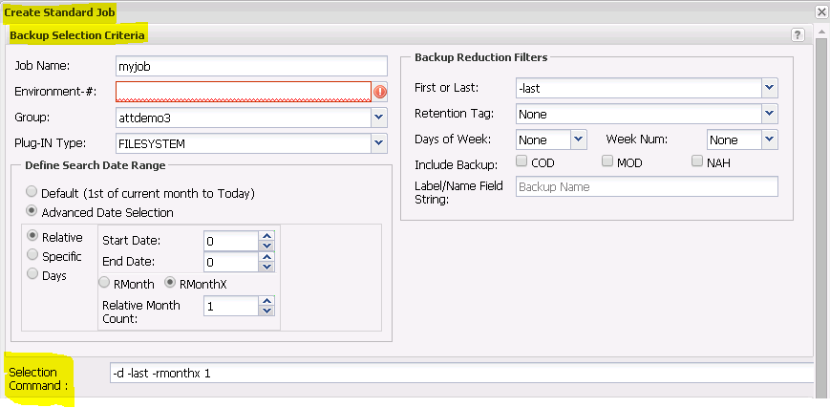
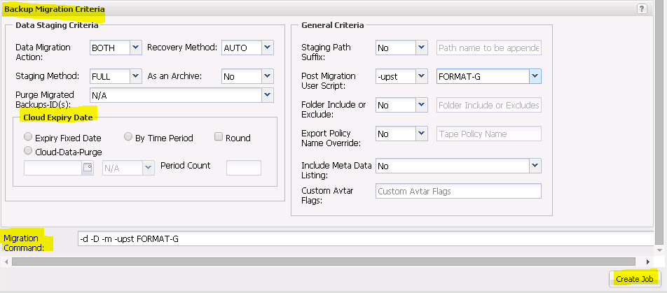
WEB-UI – Standard Job Policy Creation
Job Policy Setup Wizard is split into two panels
Notes:
Job policy creation is simplified with the Web-UI which provides an interactive wizard. Job policies contain various criteria to influence both backup selection and staging and export phases. If unfamiliar with a given parameter its advised you refer to the documentation or online help text prior to using it.
A migration is performed using a job policy which runs as a batch process on the Utility node to control all aspects of an end-to-end migration. Two types of job policies exist, a Standard policy which can be thought of as the workhorse since they perform the actual migration while the second type referred to as a Batch policy is used to simplify scheduling by calling a series of Standard policies in sequence to a given Env-#.
The following CLI command can be leveraged to create a series of job policies quickly by adding them into a script file. Some familiarity with ADMe syntax is required but after one or two calls are established creating additional calls are easy to do. Run the file as a script as often as required if changes are needed. This approach allows the creation of all jobs in adavance.
root@avutil:/atoadmin/#: cat jobbuild.sh
adme -jobcreate 'j=vmimg01,e=3,g=vmimg01,s=-vmimage –rmonthx 1 -last,m= -upst FORMAT-F -server,u=update'
adme -jobcreate 'j=winfs01,e=3,g=winfs01,s=-last,m= -upst FORMAT-F -server ,u=update'
adme -jobcreate 'j=lnxfs01,e=2,g=lncfs01,s=-first ,m= -upst FORMAT-G,u=update'

Slide 21
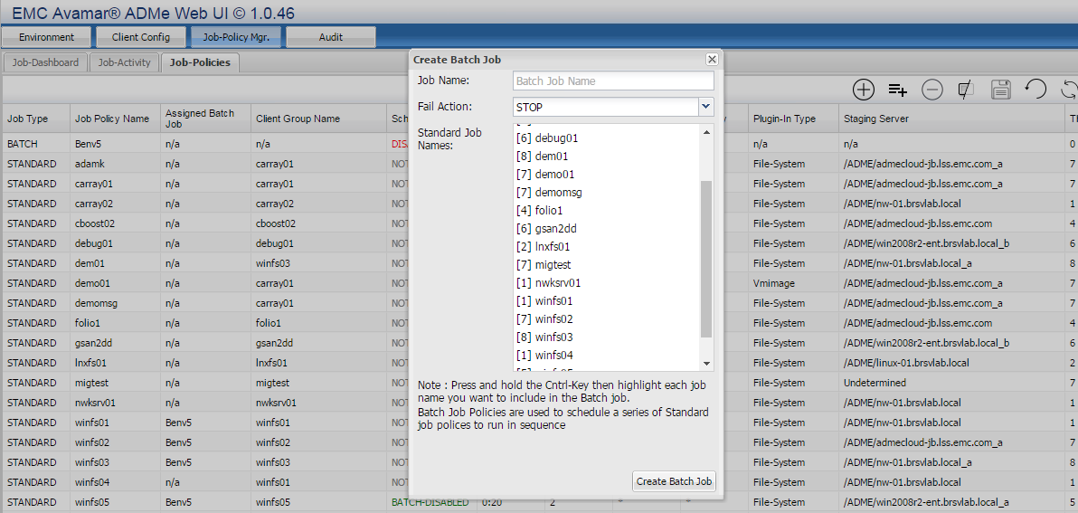
WEB-UI – Batch Job Policy Creation
Batch Policies are used to schedule a series of Standard policies sequentially to a given thread number
Simplifies scheduling when multiple jobs are required to share the same resources, staging path, thread# etc
Notes:
Batch policies are used to initiate or schedule a series of Standard Job policies and processing them sequentially. This implies each job assigned to a Batch job should share a common environment thread number. This overcomes challenges of needing to guess when a Standard job will complete and when to schedule the next job eliminating the risk of encountering an environment lock condition. Environment locks are released once the Standard job holding it ends.
Batch policies have a Fail Action attribute used to influence its behavior when one of the Standard jobs it contains fail to complete their export phase. If set to a value of STOP remaining jobs are prevented from being initiated, when set to CONTINUE any remaining jobs will in fact be called. A value of CONTINUE should only be used when staging disk is not in question such as when using incremental staging since its disk space is effectively pre allocated or when migrating to a supported cloud gateway since cloud storage is effectively infinite.

Slide 22

Job Policies Connect the Dots
To Perform the Migration process!

